Slide 1

Design Patterns in C++

Slide 2

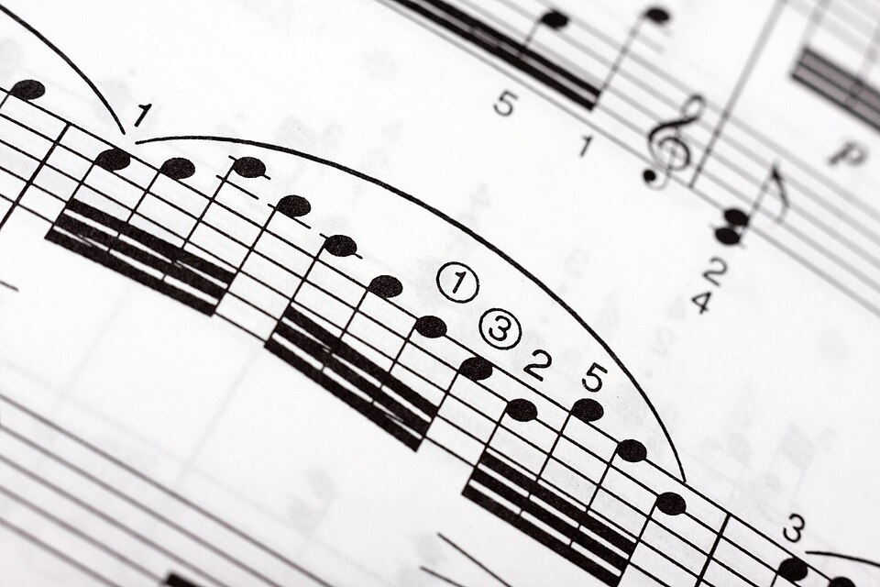
What are Design Patterns?
They are
✅ Reusable solution
✅ Shared vocabulary
Not:
❌ A library or framework
❌ A silver bullet (solution to all problems)
Notes:
A reusable solution to a problem that recurs again and again in software design — not a finished piece of code, but a template for how to solve it.
Captures the shared vocabulary experienced developers use to talk about structure ("just make it an Observer") instead of re-explaining the mechanics every time.
Not:
A library or framework you import
A silver bullet — the wrong pattern applied to the wrong problem adds complexity instead of removing it
Why they matter:
Faster communication with other engineers
Proven structure for problems you'll hit repeatedly (extensibility, decoupling, object creation)
Easier to spot in code reviews and existing codebases once you know the shapes

Slide 3
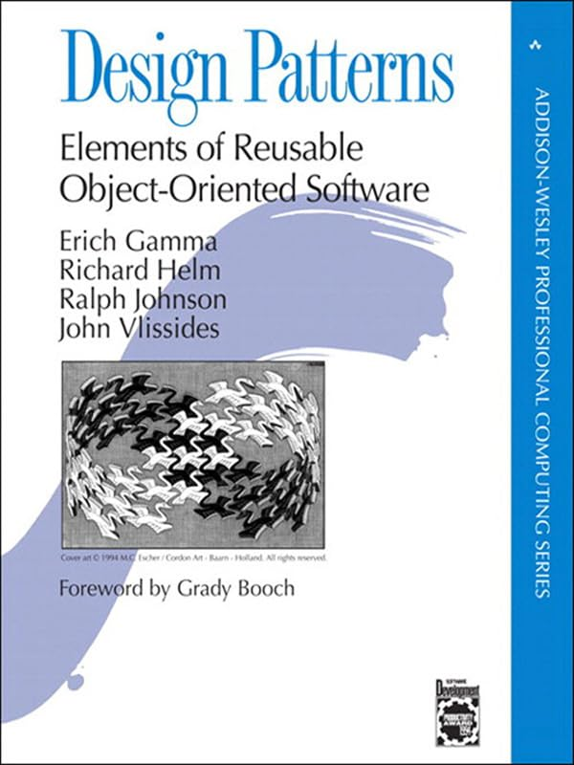

Design Patterns — The “Gang of Four”
Published in 1994
Introduced 23 classic, reusable object-oriented design patterns
Organized into Creational, Structural, and Behavioral categories.
Proven solutions to recurring software design problems.
Notes:
This idea — reusable, named solutions — got formalized in one book, in 1994, and the name stuck.
We're not going to cover all 23 today — we'll walk through 6 of them, hands-on, as before/after code.

Slide 4
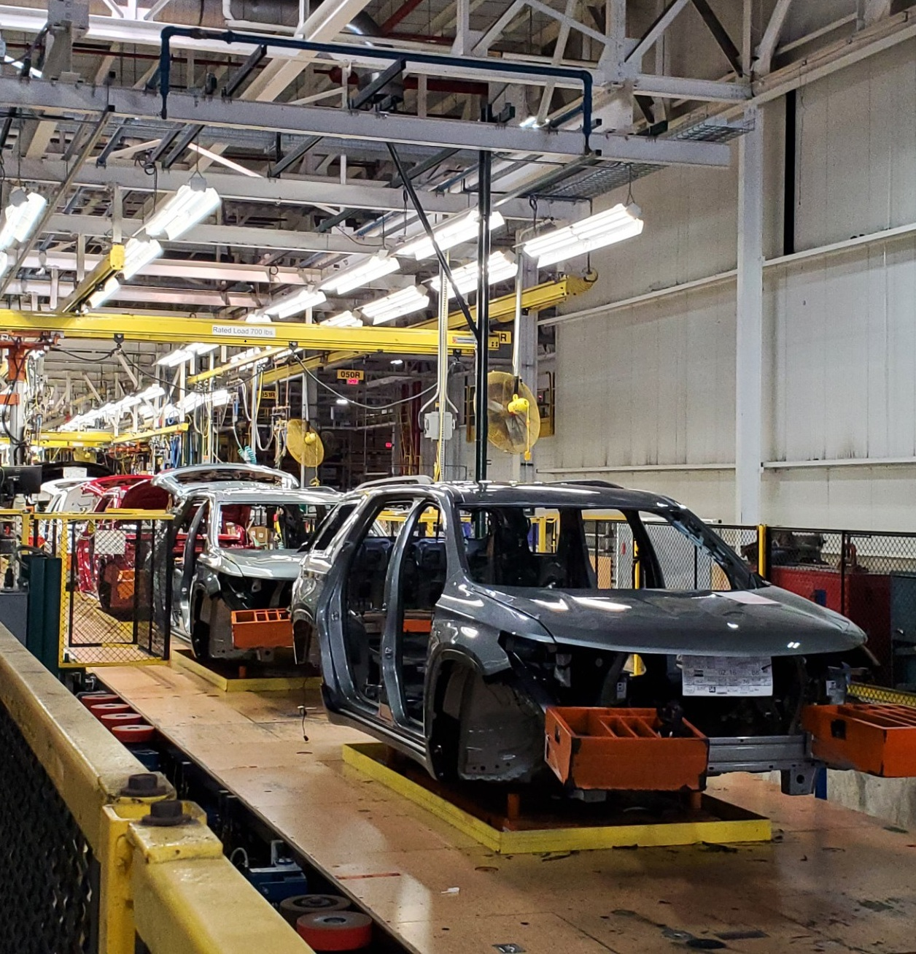
Creational Design Patterns
Code Examples
Notes:
First category — Creational. These are about how objects get created, not what they do once they exist.

Slide 5
Creational Design Patterns
Purpose: Provide flexible and reusable ways to create objects, while hiding or decoupling the object-creation logic from the code that uses them.
The 5 GoF Creational Patterns
Singleton — Ensures a class has only one instance and provides a global access point.
Factory Method — Defines an interface for creating objects while allowing subclasses to decide what to instantiate.
Abstract Factory — Creates families of related objects without specifying their concrete classes.
Builder — Constructs complex objects step-by-step, allowing different representations of the same object.
Prototype — Creates new objects by cloning existing objects, useful when object creation is expensive.

Slide 6
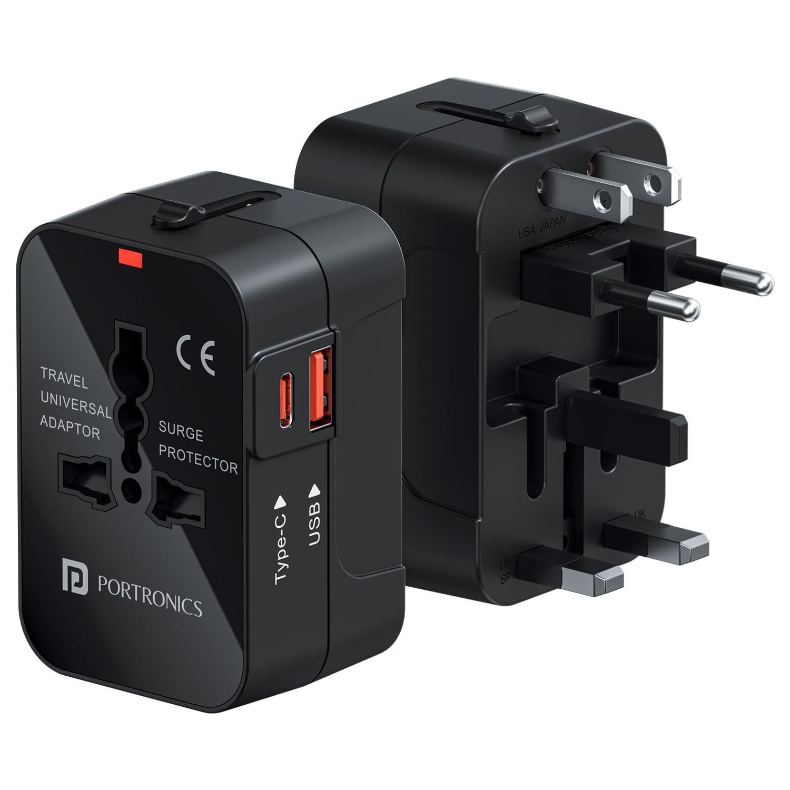
Structural Design Patterns
Code Examples
Notes:
Second category — Structural. These are about how objects and classes are composed into larger structures.

Slide 7
Structural Design Patterns
Purpose: Define how classes and objects are composed and connected to form larger, flexible structures.
The 7 GoF Structural Patterns
Adapter — Makes incompatible interfaces work together.
Bridge — Separates abstraction from implementation so both can evolve independently.
Composite — Treats individual objects and compositions of objects uniformly.
Decorator — Adds responsibilities or behaviour to objects dynamically.
Facade — Provides a simple interface to a complex subsystem.
Flyweight — Shares common data across many objects to reduce memory usage.
Proxy — Provides a substitute or placeholder that controls access to another object.

Slide 8

Behavioral Design Patterns
Code Examples
Notes:
Last category — Behavioral. These are about how objects talk to each other and divide responsibility.

Slide 9
Behavioral Design Patterns
Purpose: Define how objects communicate, collaborate, and distribute responsibilities.
The 11 GoF Behavioral Patterns
Chain of Responsibility — Passes a request through a chain of potential handlers.
Command — Encapsulates a request as an object, enabling operations such as undo/redo.
Interpreter — Defines a representation for a language and provides an interpreter.
Iterator — Provides a way to traverse a collection without exposing its internal structure.
Mediator — Centralizes communication between objects to reduce direct dependencies.
Memento — Captures and restores an object's previous state.
Observer — Notifies dependent objects when an object's state changes.
State — Allows an object to change its behavior when its internal state changes.
Strategy — Encapsulates interchangeable algorithms or behaviors.
Template Method — Defines the skeleton of an algorithm while allowing subclasses to customize steps.
Visitor — Adds operations to object structures without modifying the objects themselves.

Slide 10
Questions & Discussions
https://github.com/jerrykorulla/design-patterns-examples

